Slide 1



AxisBank Stock market Analysis
View in Power BI

Slide 2
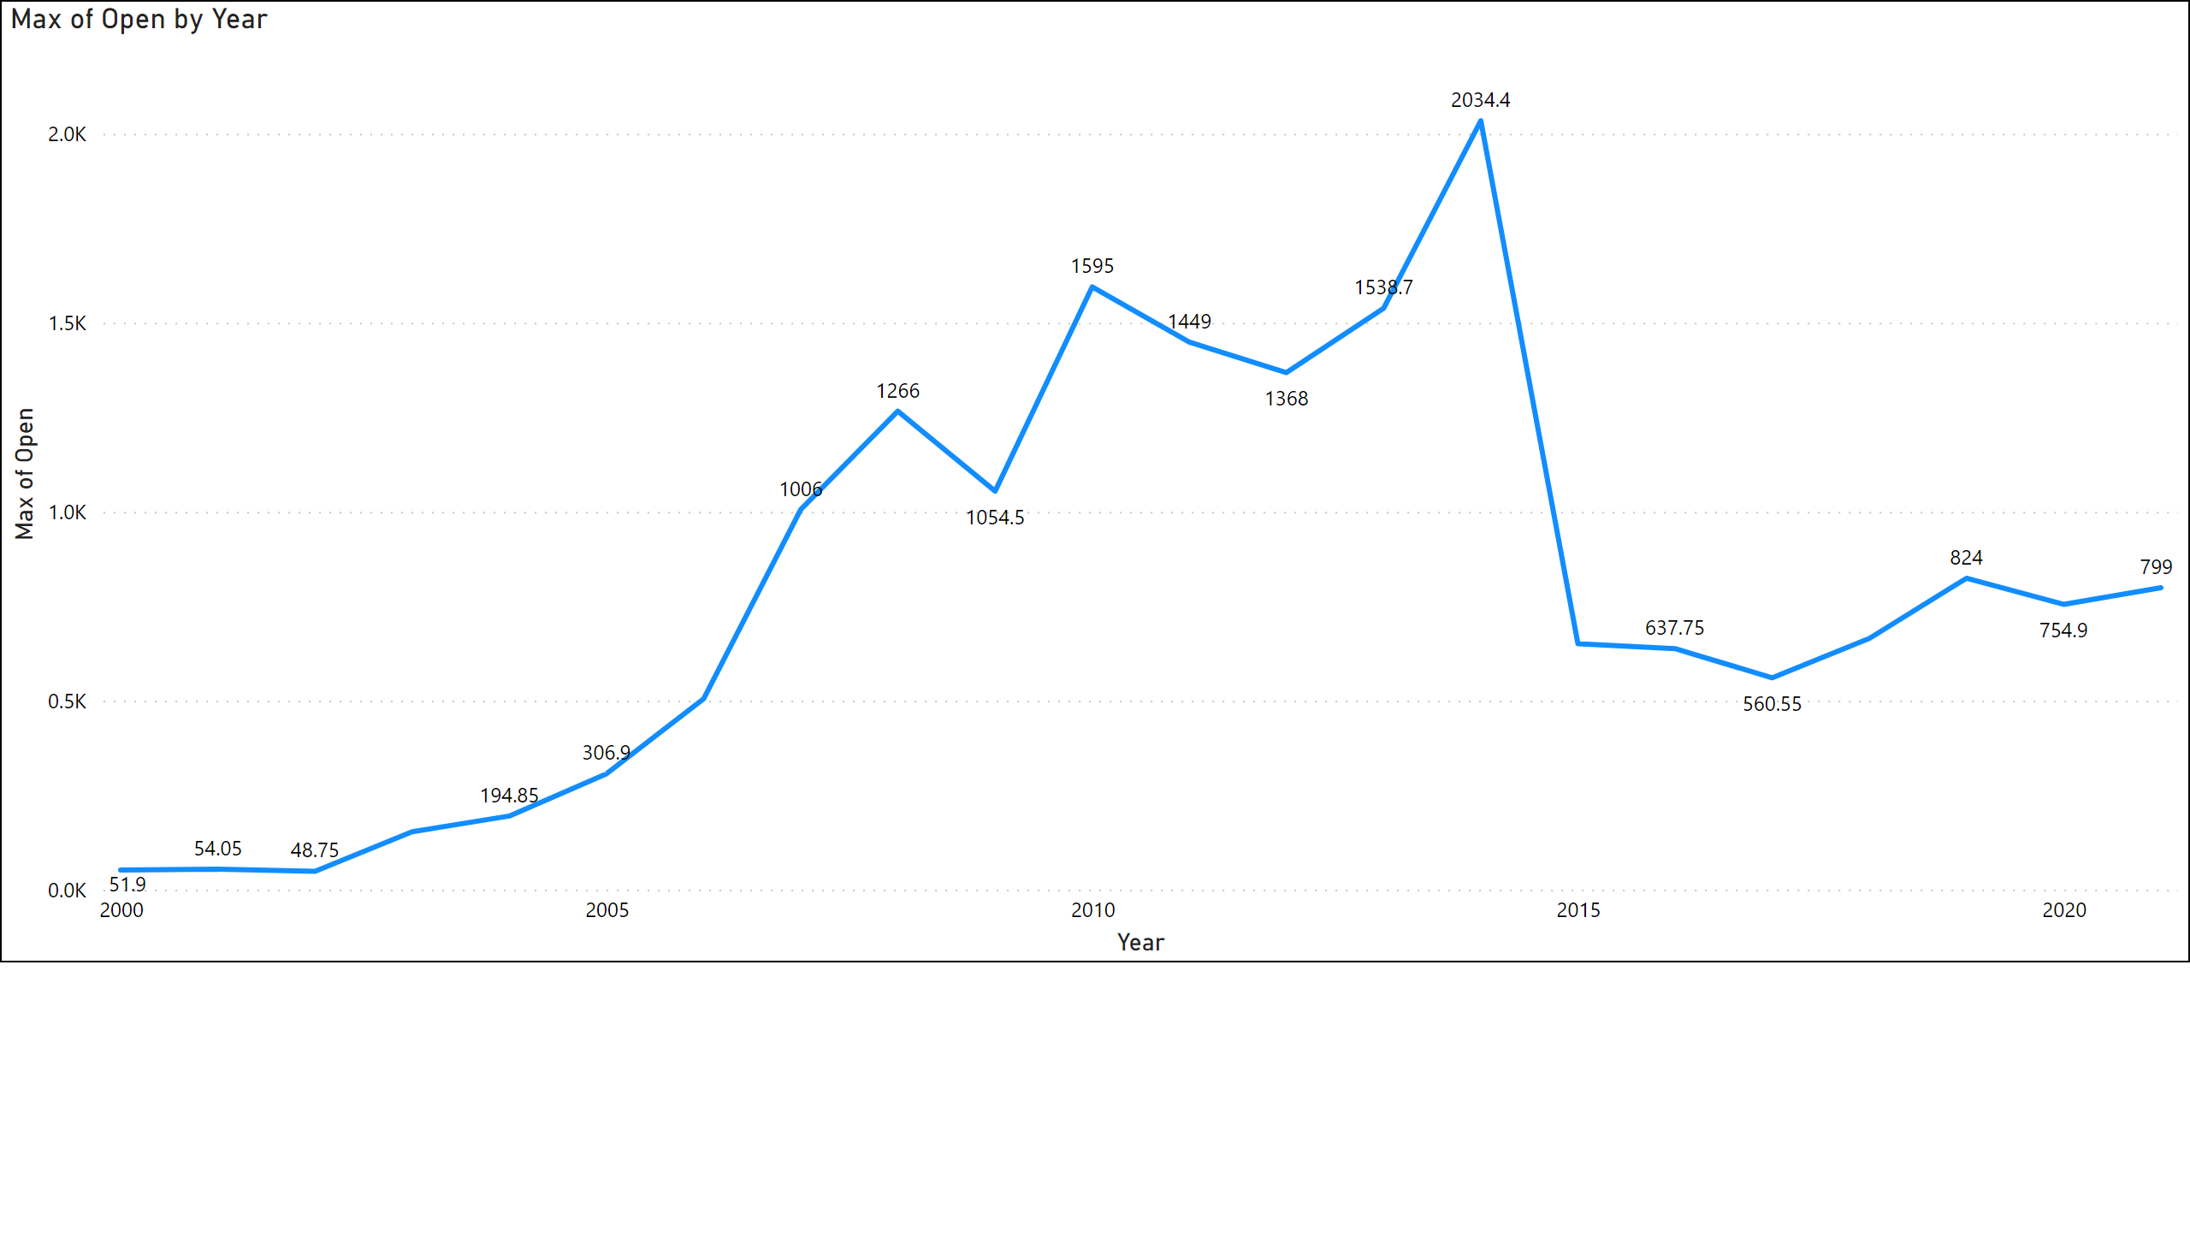
Page 2
Highest opening price of the stock was 2034.4 which was on July 2014 .
Lowest opening price of the stock was 54.9 on 2000 .
According to the current trend in March 2021 the last recorded opening price was 799.
Notes:
lineChart
No alt text provided

Slide 3
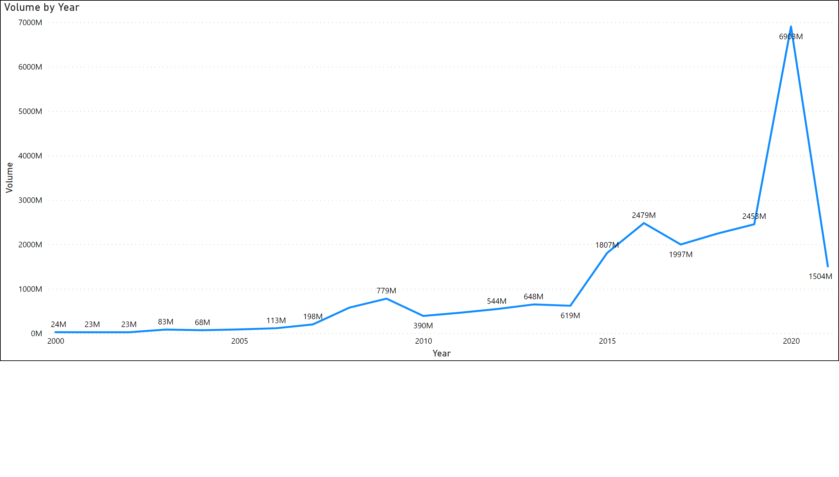
Page 3
This chart show the volume By year , Axis Bank as the highest volume of stock purchase is 6903 Millions in 2020 and lowest of 24 Millions in 2000.
Notes:
lineChart
No alt text provided

Slide 4
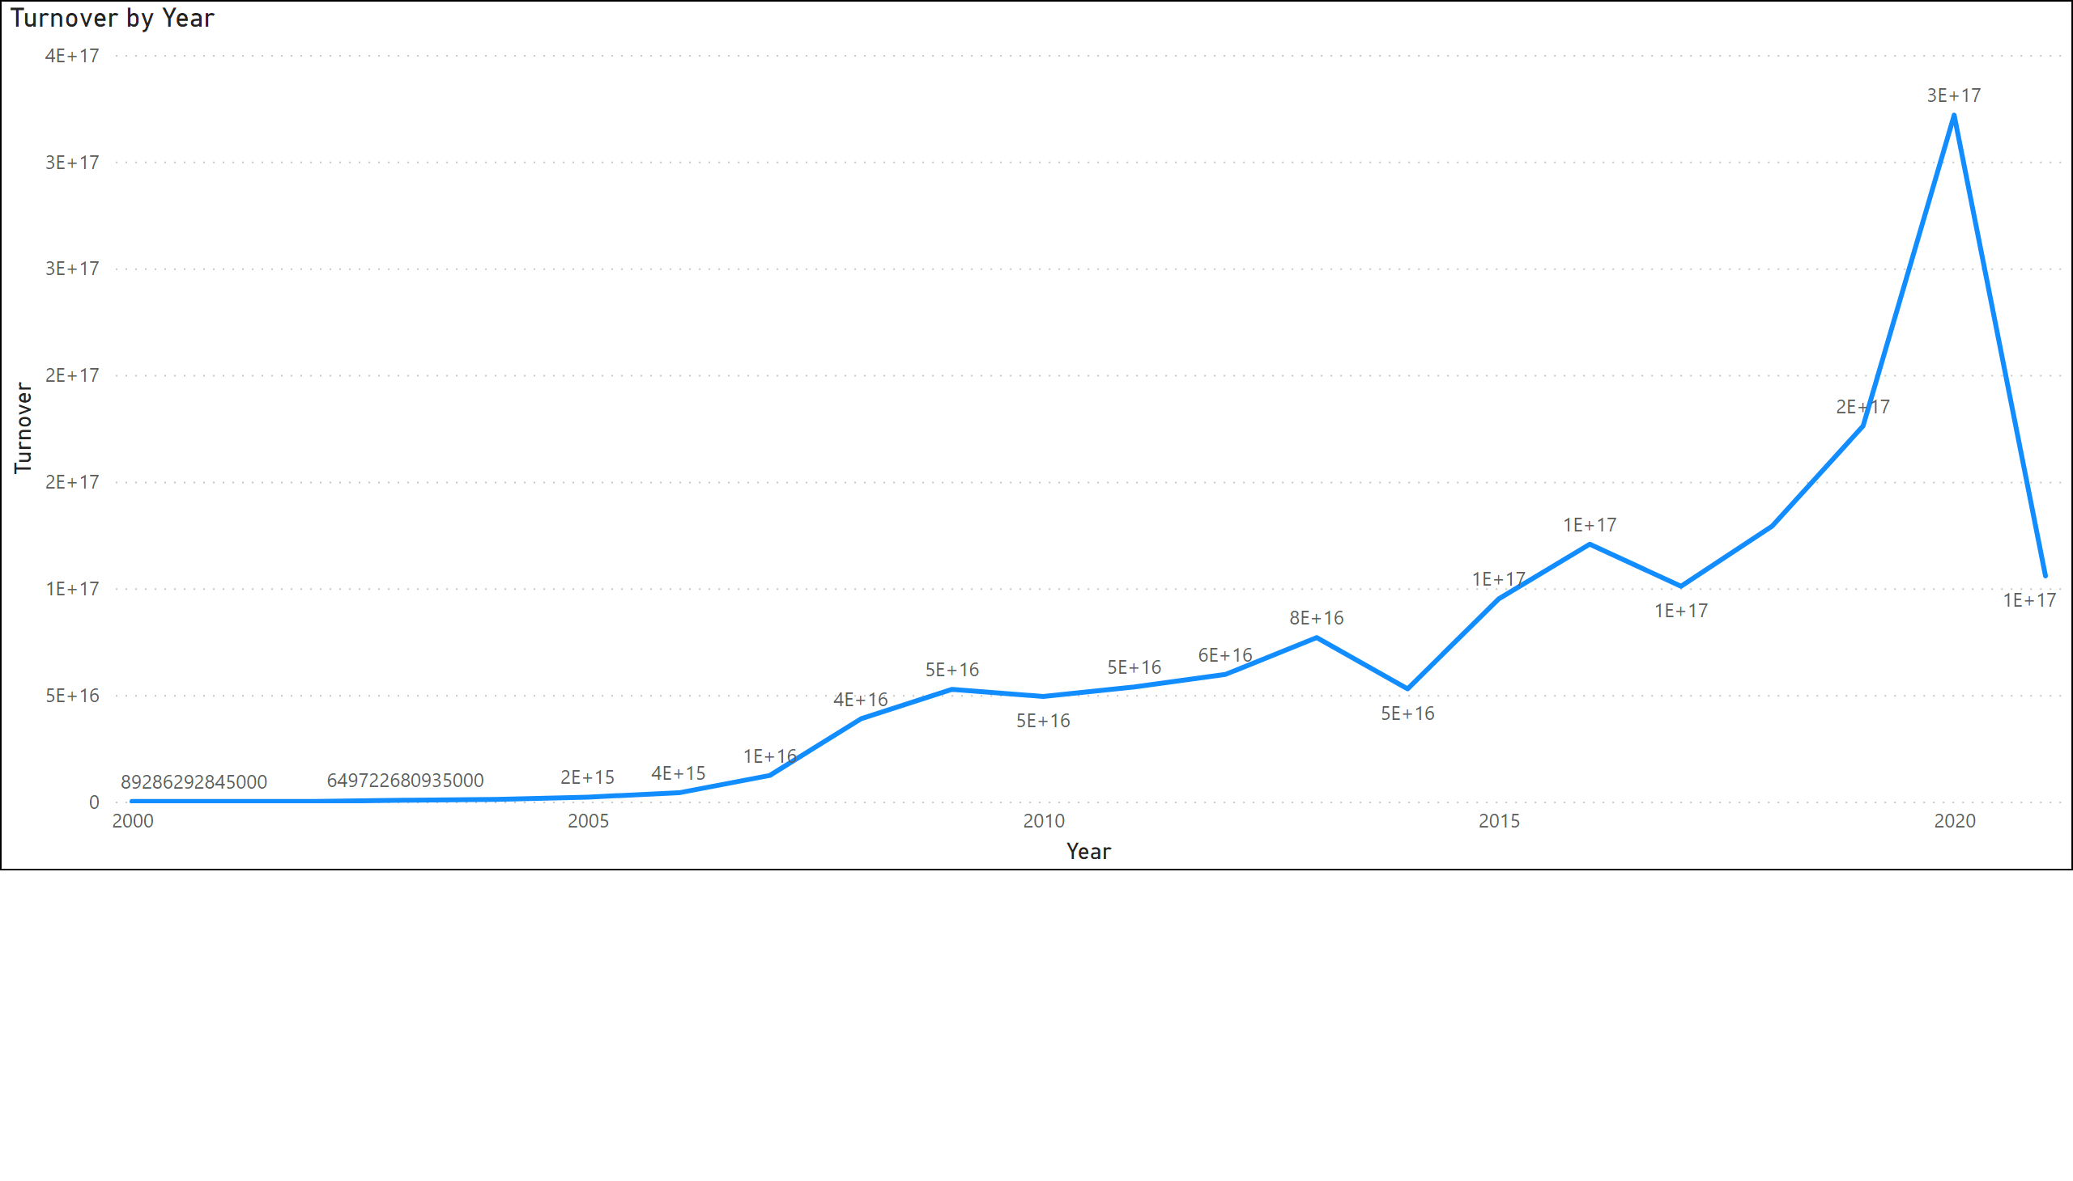
Page 5
This chart represent the Turnover of the company.
Notes:
lineChart
No alt text provided

Slide 5
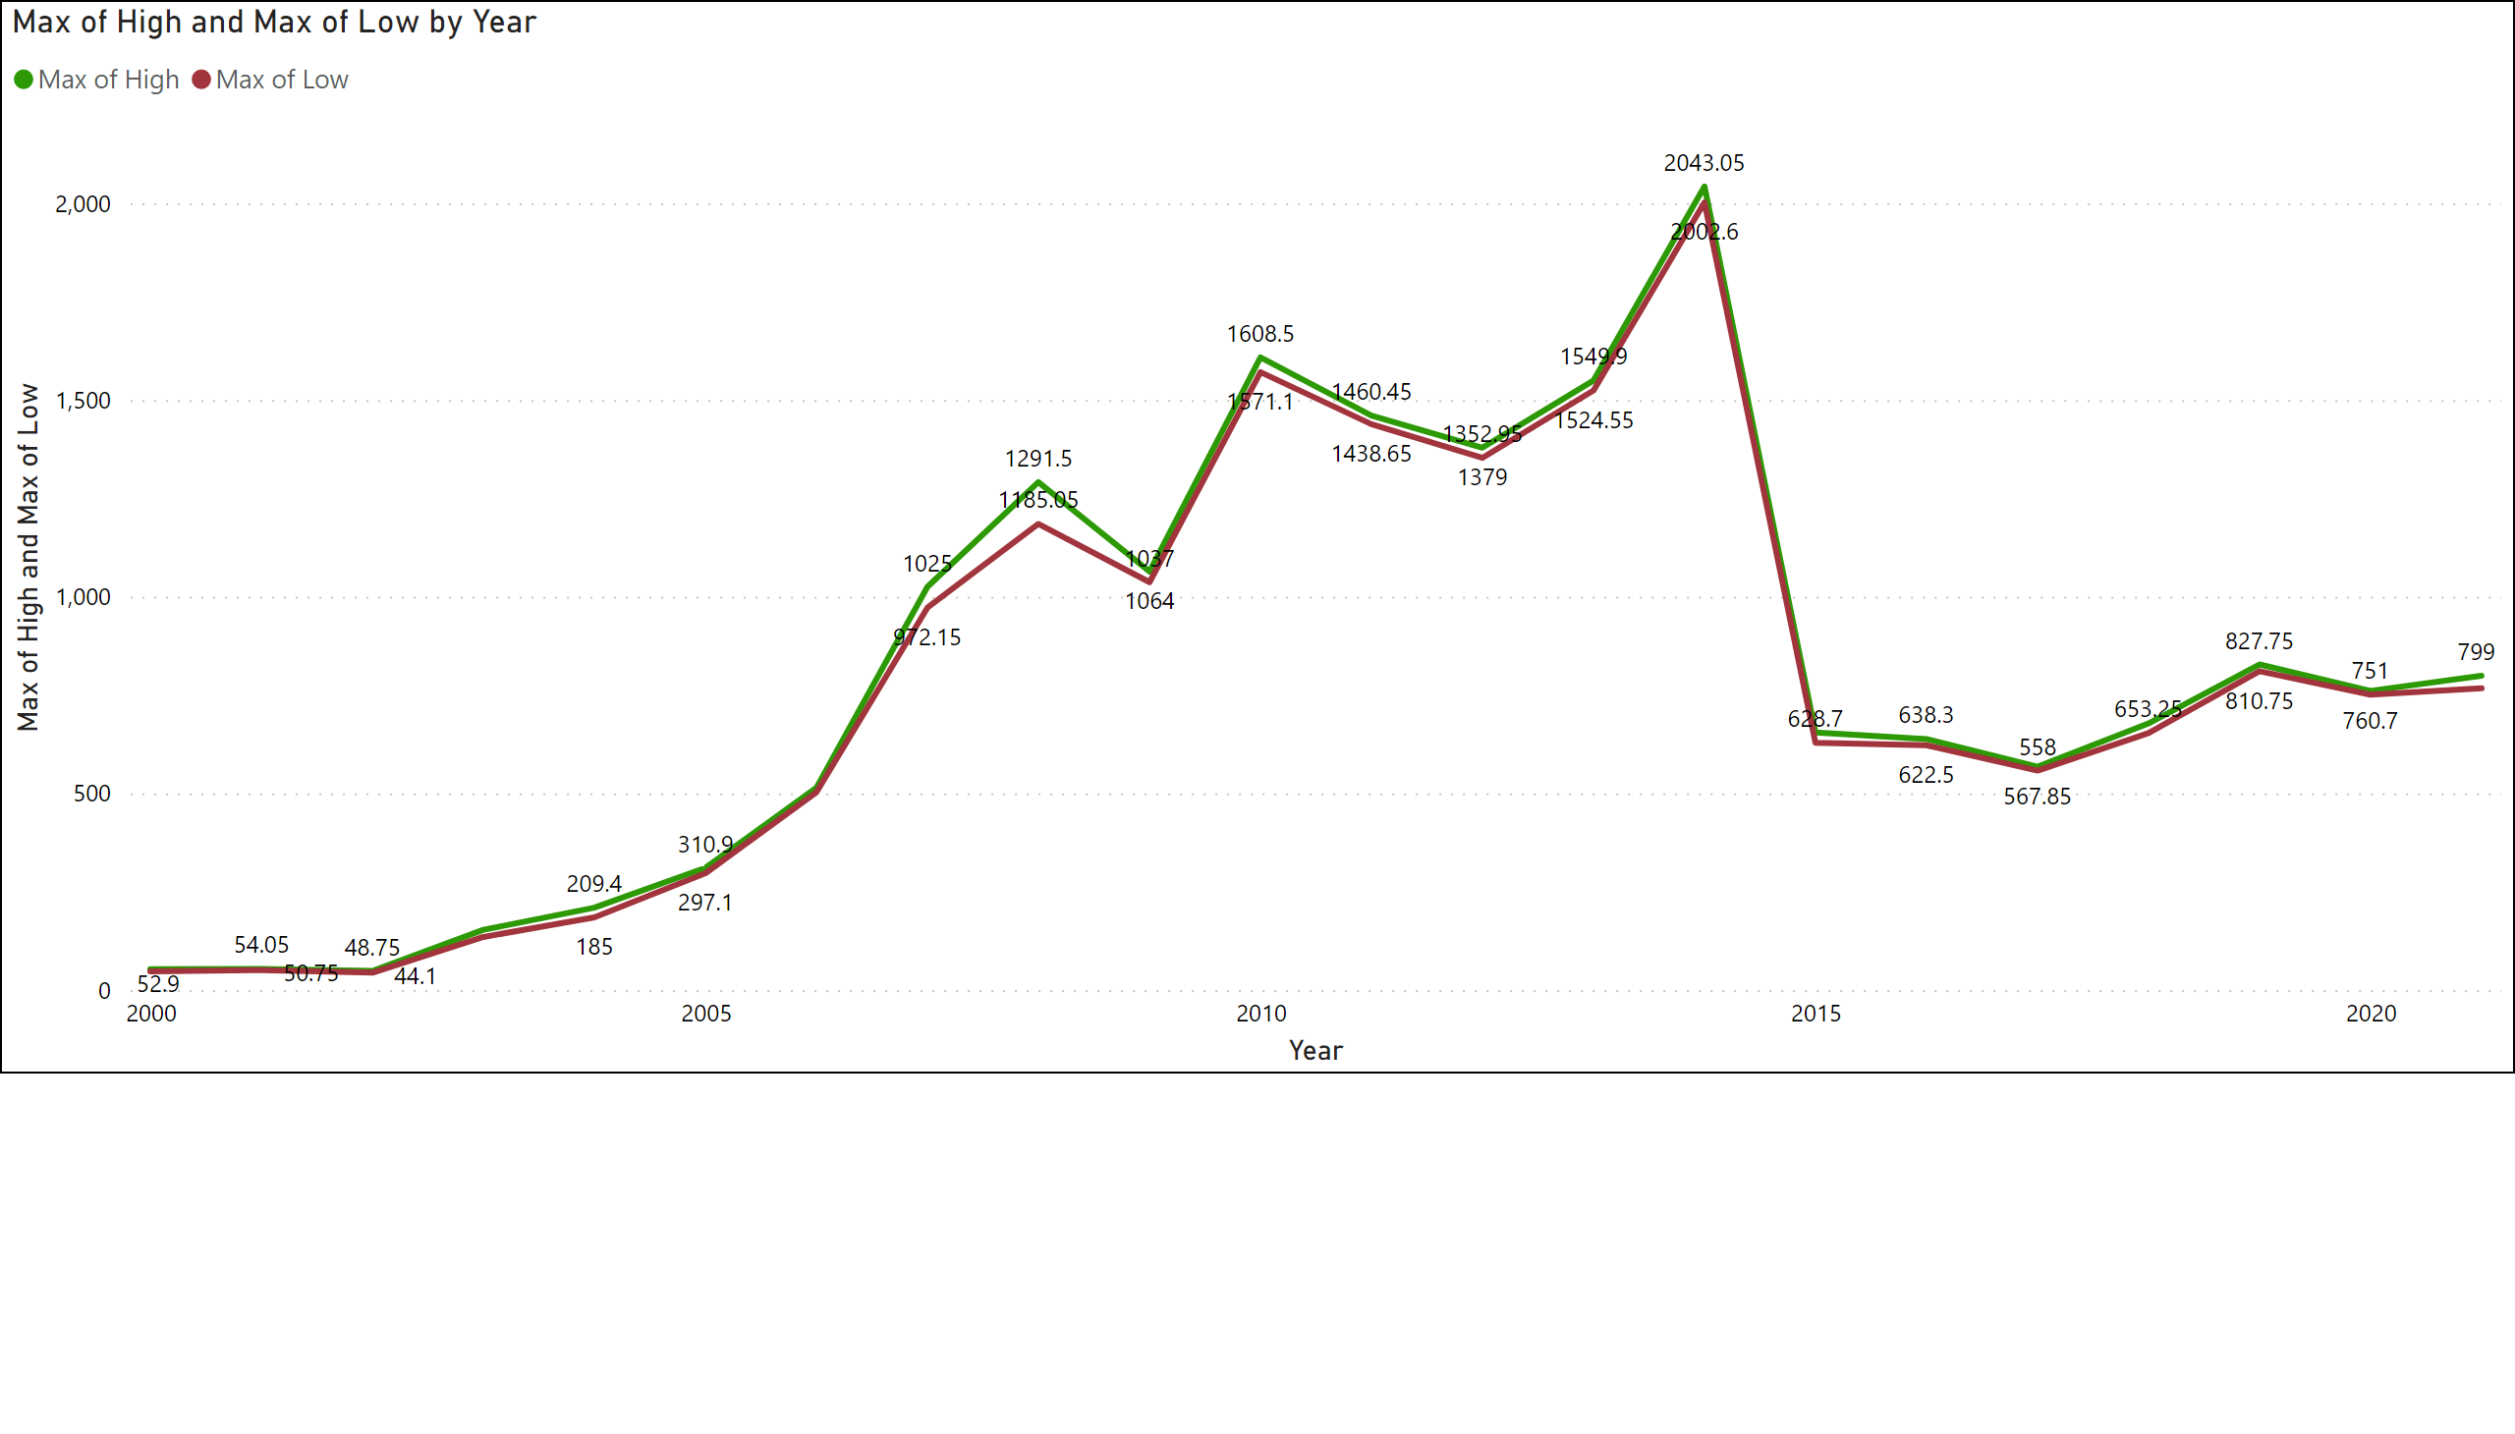
Page 4
This chart represent the High and low of Axis Bank Stock price, red colour represent the low and green represent High.
Notes:
lineChart
No alt text provided

Slide 6
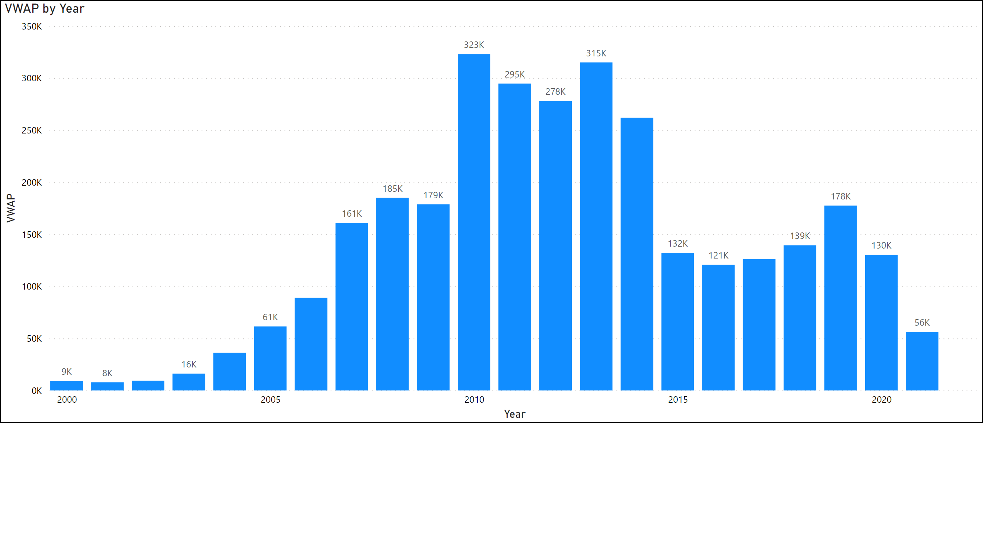
Page 7
The volume-weighted average price (VWAP) is a measurement that shows the average price of a security, adjusted for its volume.
Above can be seen that the average price a security has traded at throughout the day, based on volume and price
Notes:
columnChart
No alt text provided

Slide 7
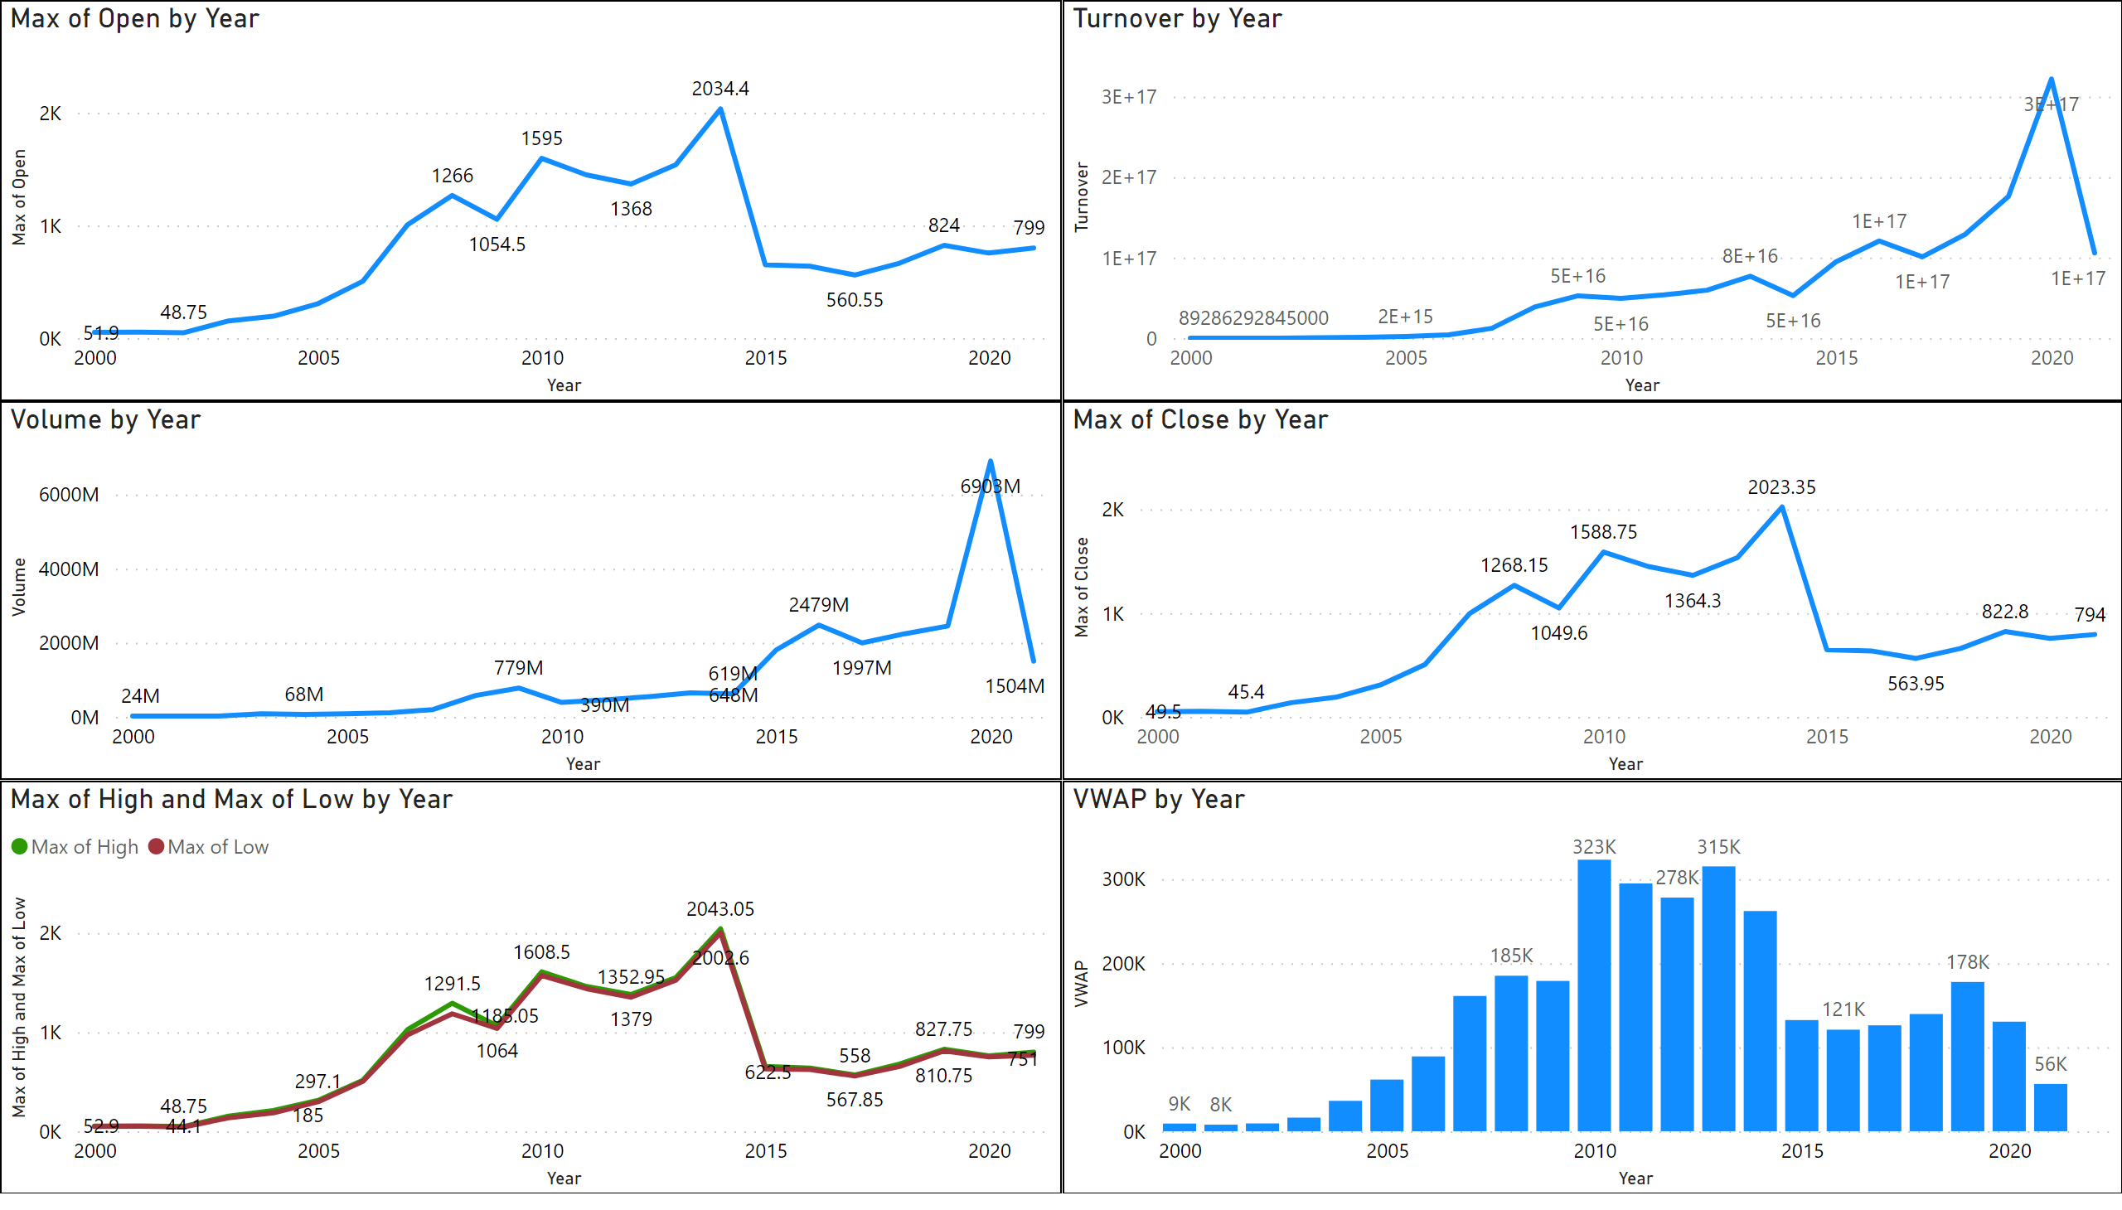
Page 1
Notes:
lineChart
No alt text provided
lineChart
No alt text provided
lineChart
No alt text provided
lineChart
No alt text provided
columnChart
No alt text provided
lineChart
No alt text provided

Slide 8
CONCLUSIUON
So, After the company faced a huge market crash in stock price in 2011, company is showing a stable growth in the price stock from 2011-2021 .
For the investors who wants to invest in Axis Bank Stock It could be said that I would be a safe and good long term investment.
Titan has a strong foot in India and has got the trust of the citizens of India that is a valuable company. So overall it’s a good company with good stock price history.

